Slide 1




Instruct virtual course on
Single Particle Analysis by CryoEM:
Atomic modeling
CNB-CSIC, Madrid, December 14 – 18, 2020
Roberto Marabini
Marta Martínez

Slide 2
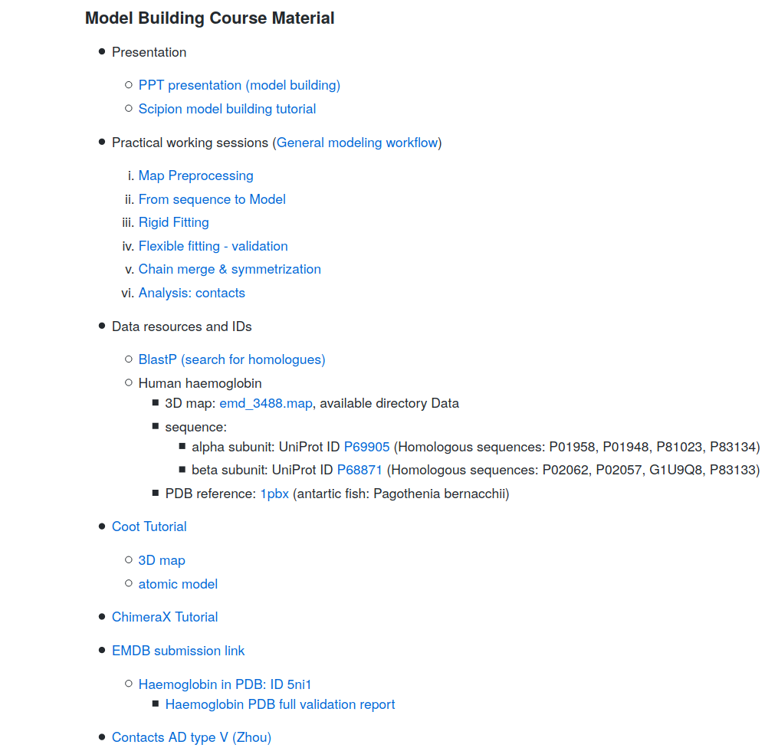
https://github.com/I2PC/scipion-courses/wiki/Instruct-virtual-course-on-Single-Particle-Analysis-2020

Slide 3
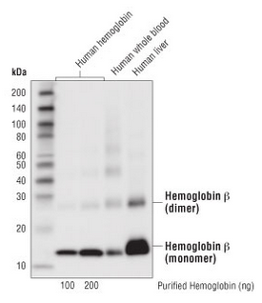
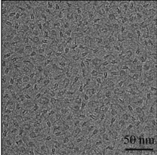
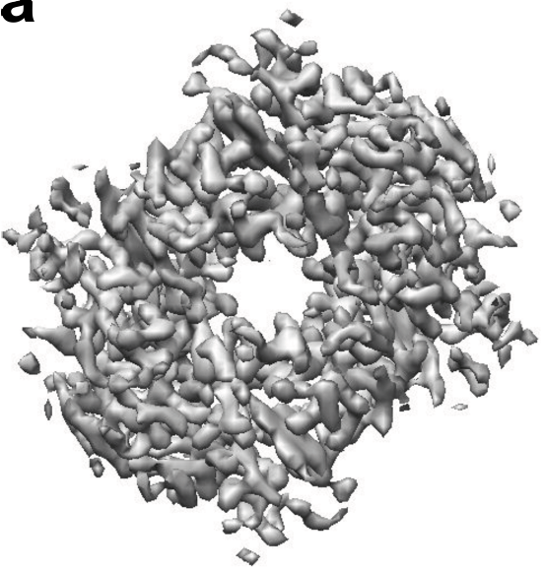
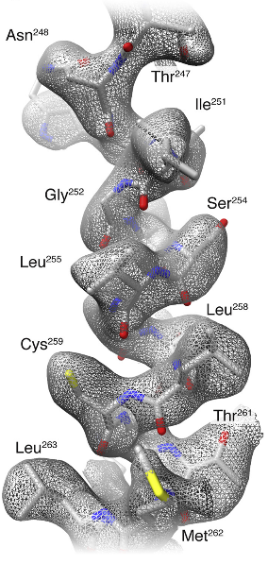
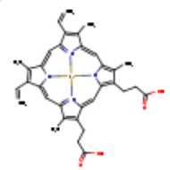
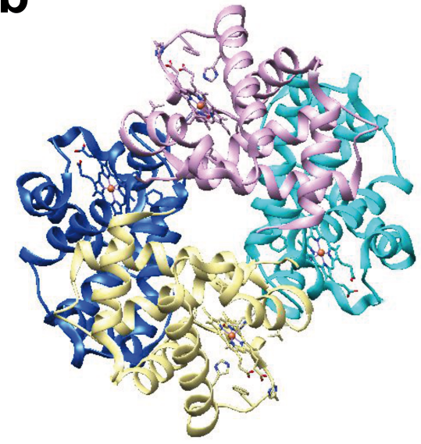
Approach to the problem
Electron density map
Model building
SPA workflow
www.cellsignal.com
2 Hemoglobin subunit α (141 aa)
4 HEME
2 Hemoglobin subunit β (146 aa)
Atomic model
(Khoshouei et al., 2017)

Slide 4
Model building
Basic steps
Tools

Slide 5
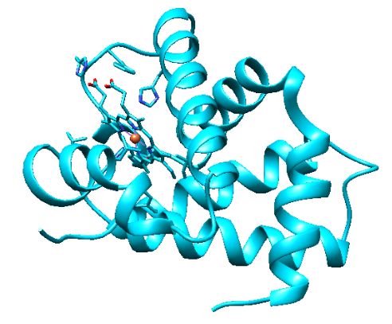
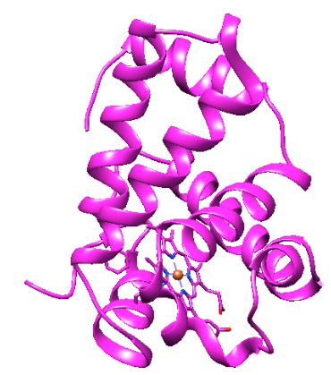
1.- Get the initial model (s)
Homology modeling
Our proteins borrow
the structure
of similar proteins
www.cellsignal.com
2 Hemoglobin subunit α (141 aa)
4 HEME
2 Hemoglobin subunit β (146 aa)
1st clue:
Skeleton of α carbons
and
many side chains

Slide 6
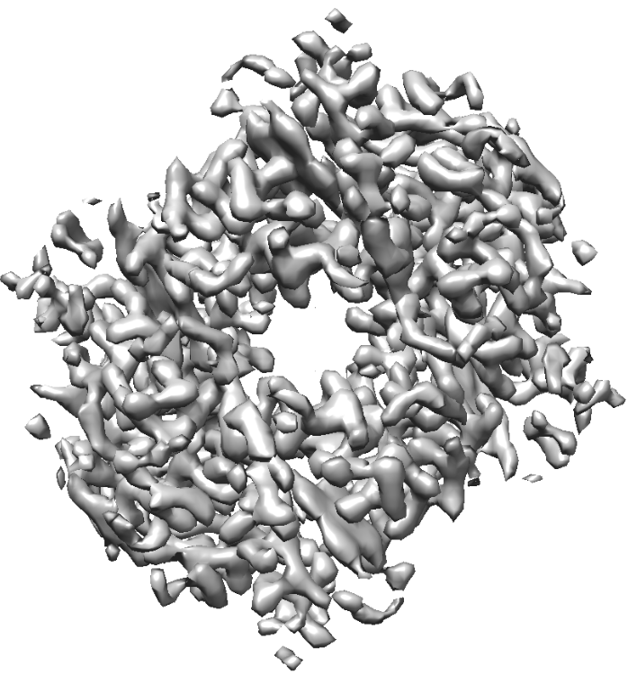
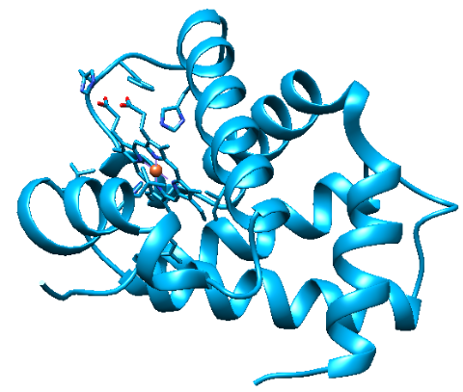
2.- Rigid fitting of model(s) in map

Slide 7
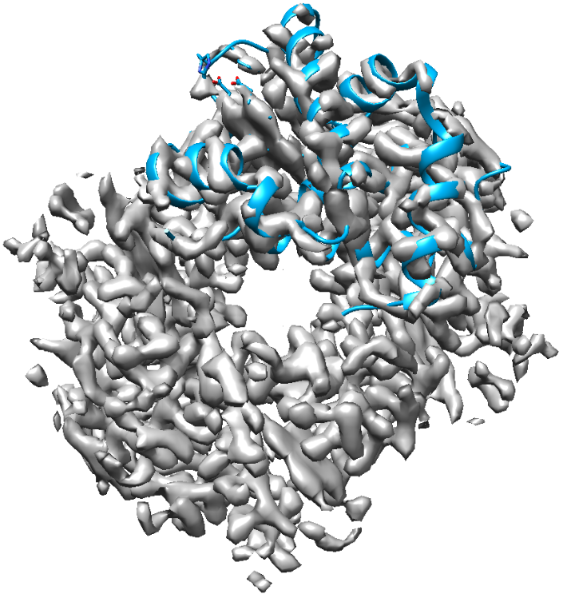
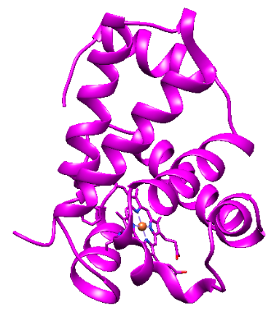
2.- Rigid fitting of model(s) in map

Slide 8
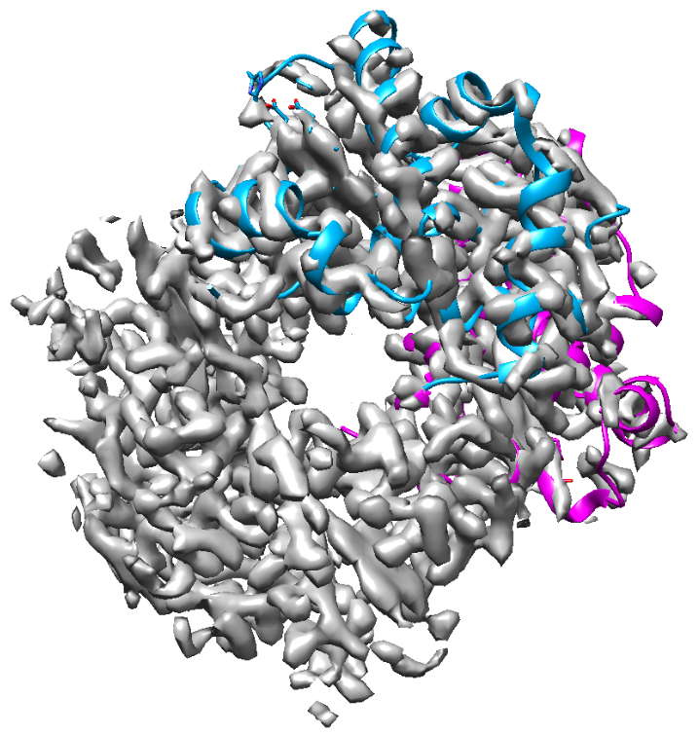
2.- Rigid fitting of model(s) in map

Slide 9
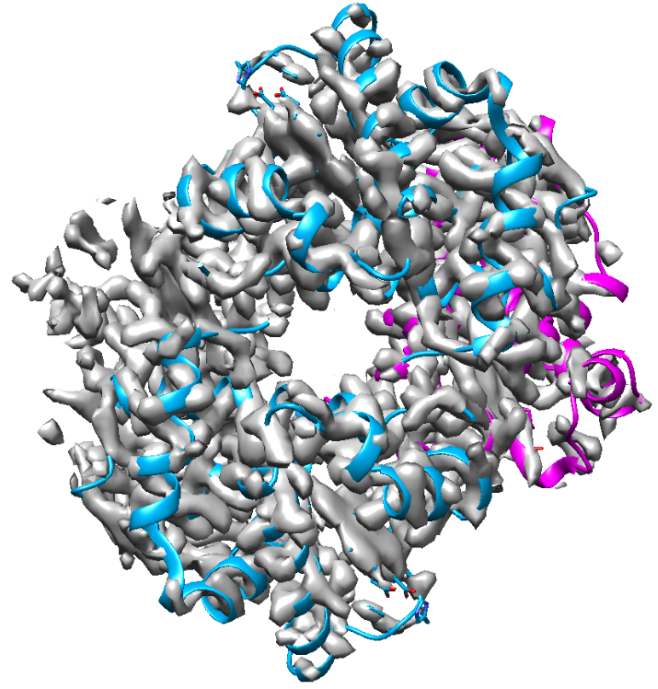
2.- Rigid fitting of model(s) in map

Slide 10
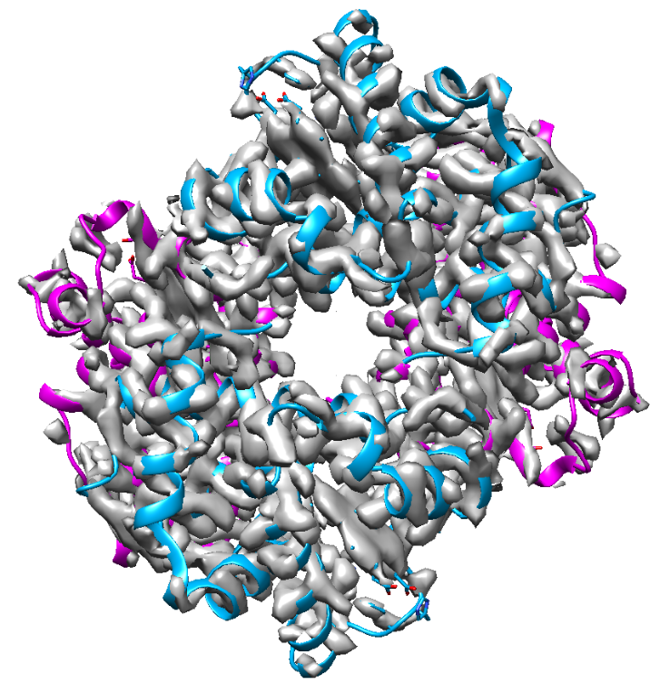
2.- Rigid fitting of model(s) in map

Slide 11
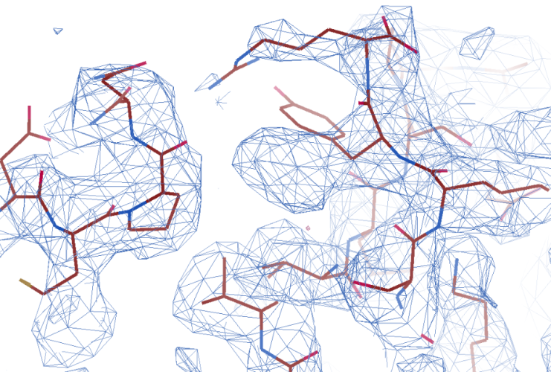
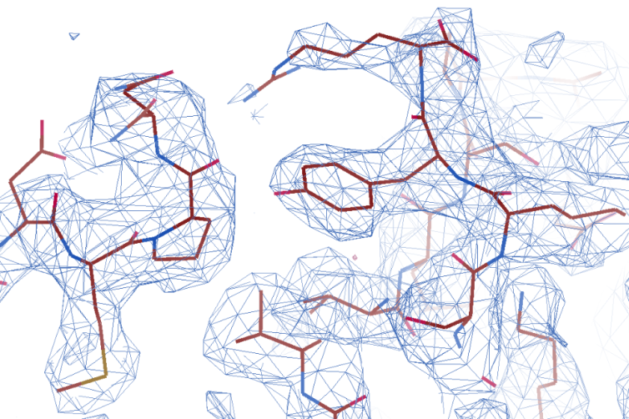
3.- Flexible fitting (refinement) of model(s) in map
Get the final model(s)
Manual and automatic

Slide 12
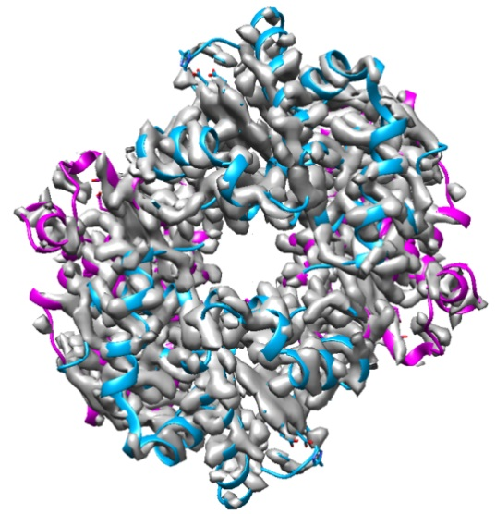


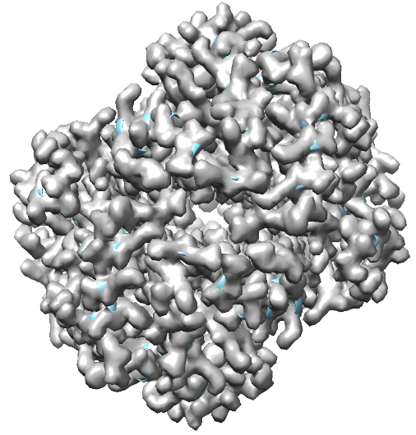

4.- Model(s) validation
Is this structure reliable?
Map and model similarity
Geometry
Map/model
fitting
PDB
Is this structure similar
to structures of the database?
(Bond lengths, angles, contacts …)
Is the map derived from the model similar to the original map?
Q (Submission)

Slide 13
the problem
Model building
Basic steps
0.- Map preprocessing
1.- Get the initial model (s)
2.- Rigid fitting of model(s) in map
3.- Flexible fitting (refinement)
of model(s) in map
4.- Model(s) validation
Tools

Slide 14
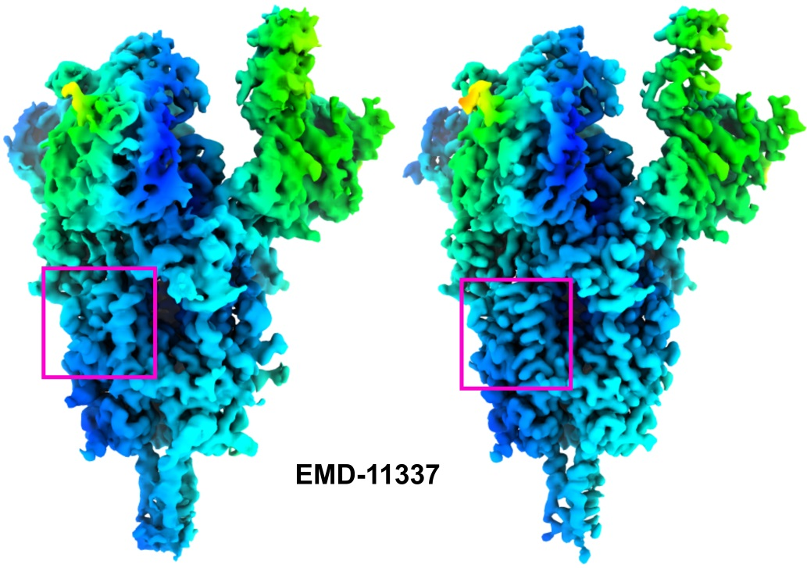
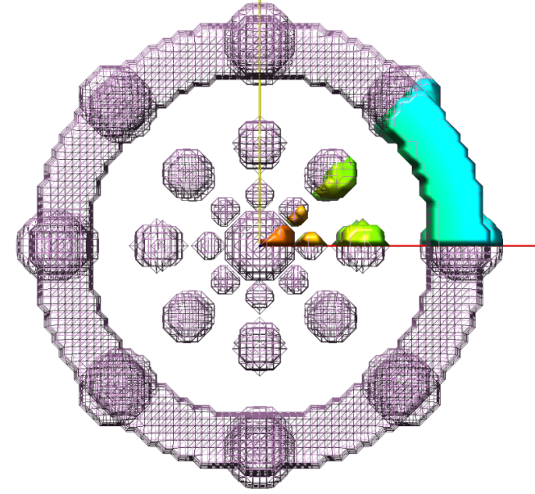
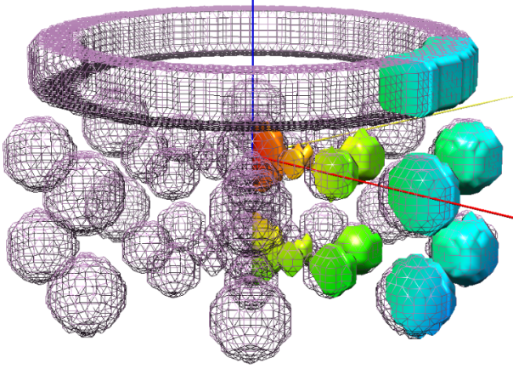
0.- Map preprocessing
Map optimization
(sharpening, improving density)
DeepEMhancer (Sánchez et al., 2020)
Extract asymmetric unit (geometrical)
sym C8

Slide 15
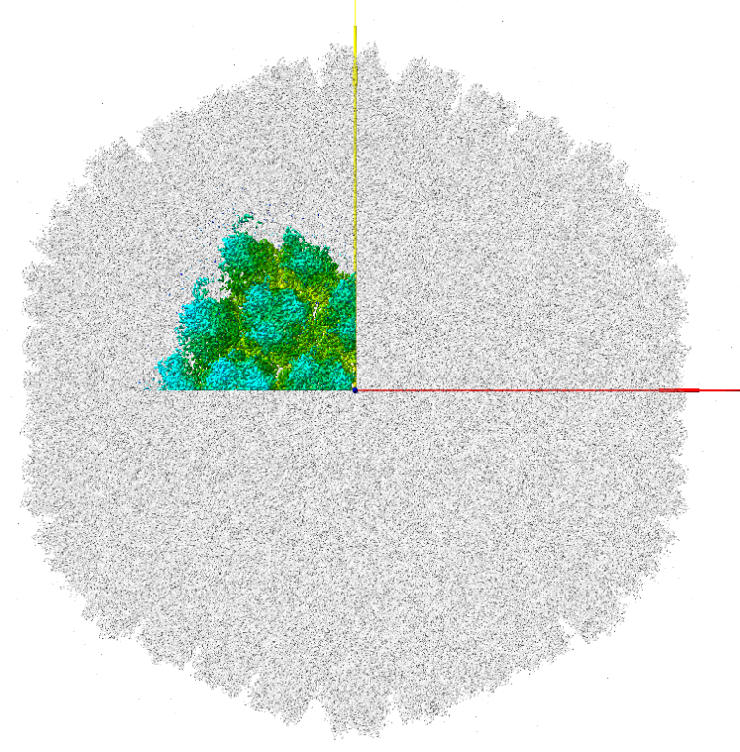
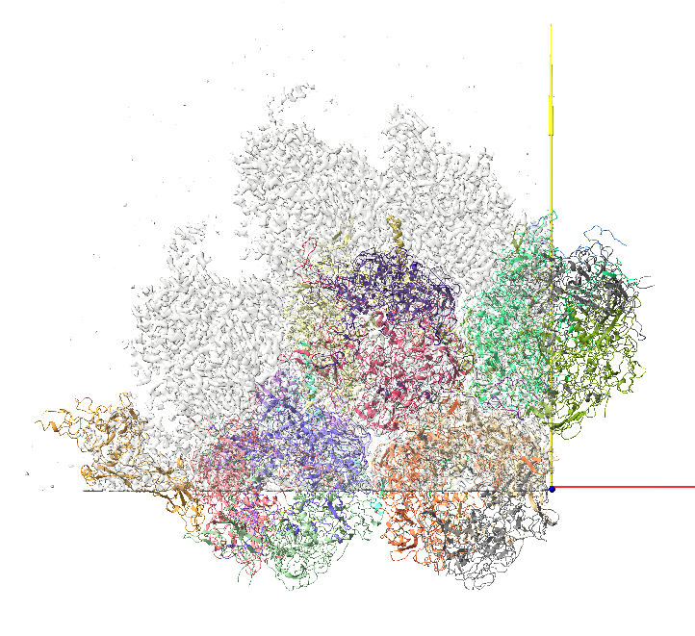
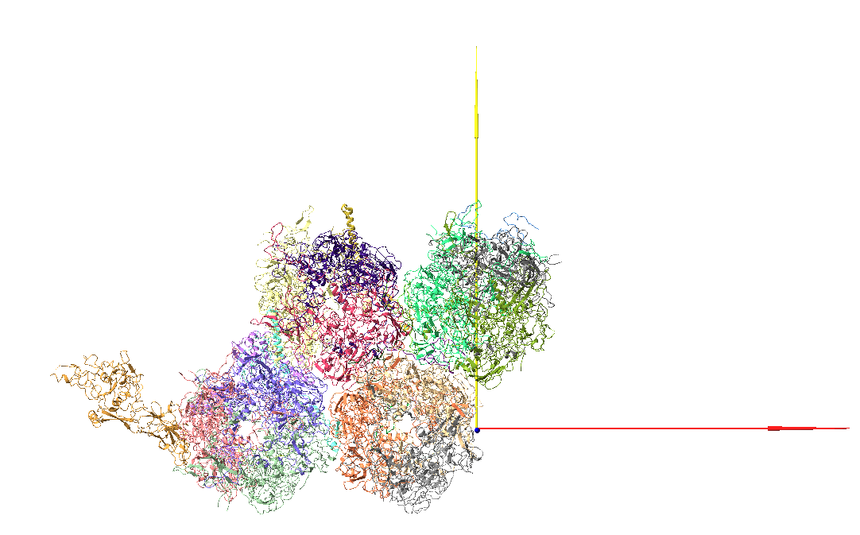
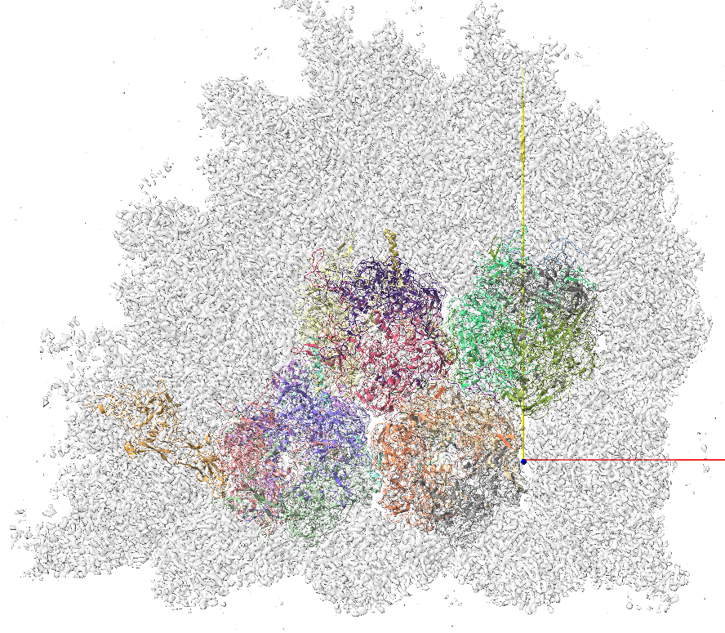
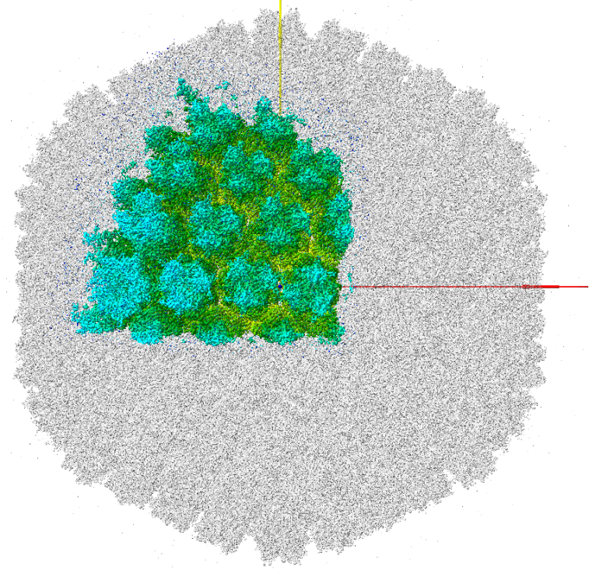
Asymmetric unit
(geometrical)
EMD-10768
6YBA
(biological)

Slide 16
the problem
Model building
Basic steps
0.- Map preprocessing
1.- Get the initial model (s)
2.- Rigid fitting of model(s) in map
3.- Flexible fitting (refinement)
of model(s) in map
4.- Model(s) validation
Tools

Slide 17
the problem
Model building
Basic steps
0.- Map preprocessing
1.- Get the initial model (s)
2.- Rigid fitting of model(s) in map
3.- Flexible fitting (refinement)
of model(s) in map
4.- Model(s) validation
Tools

Slide 18

Tools
* Borrowed from crystallography
* Specifically designed for cryo-EM data
(Cassidy et al.)

Slide 19
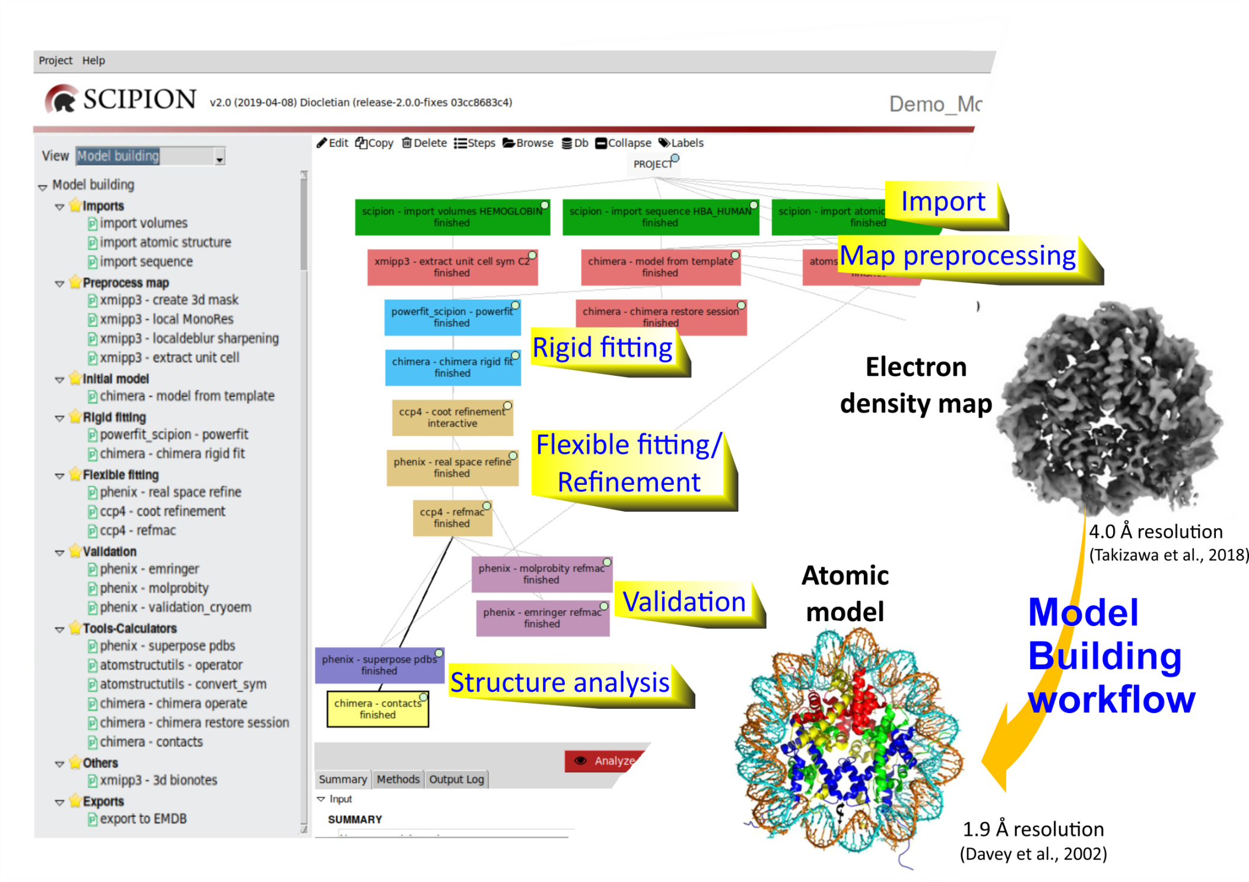
Martínez M et al. Integration of Cryo-EM Model Building Software in Scipion. J Chem Inf Model. 2020

Slide 20
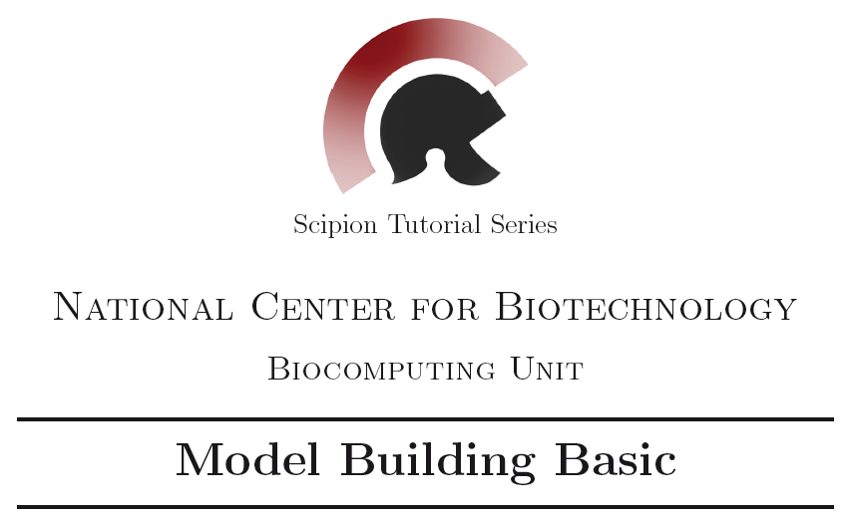
https://github.com/I2PC/scipion/wiki/tutorials/tutorial_model_building_basic.pdf

Slide 21
Human Haemoglobin
subunit α (141 aa)
subunit β (146 aa)
subunit β (146 aa)
subunit α (141 aa)
sym C2; 3.2 Å resolution
(Khoshouei et al., 2017)

Slide 22
Human Haemoglobin
subunit α (141 aa)
subunit β (146 aa)
subunit β (146 aa)
subunit α (141 aa)
sym C2; 3.2 Å resolution
(Khoshouei et al., 2017)

Slide 23
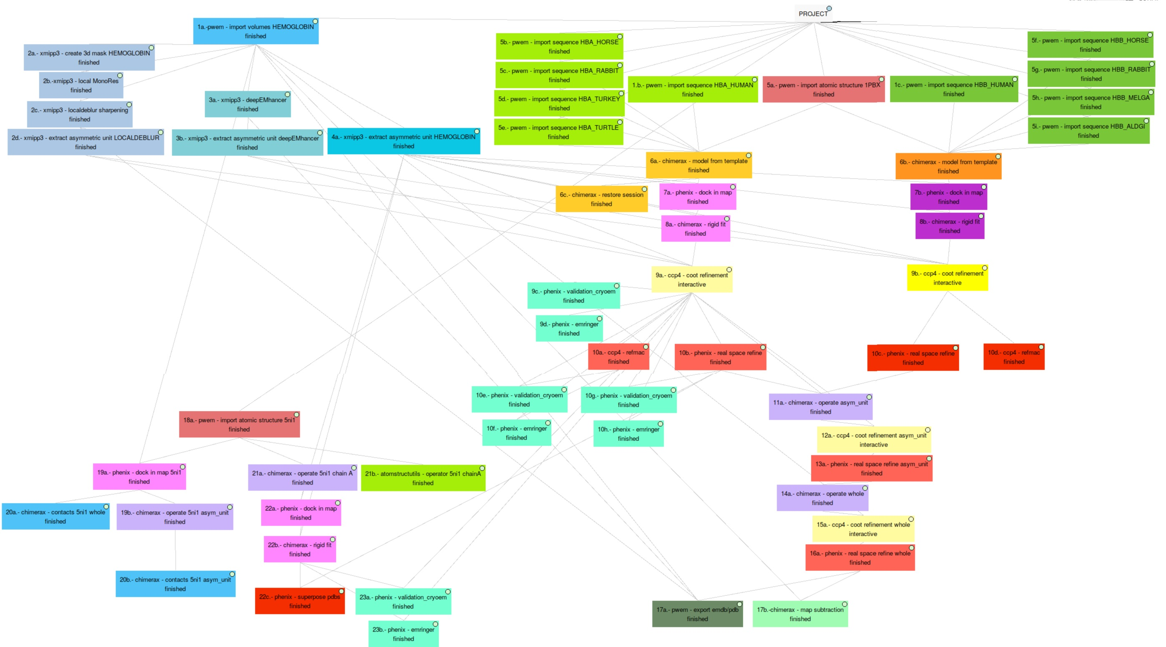

Slide 24


